Slide 1
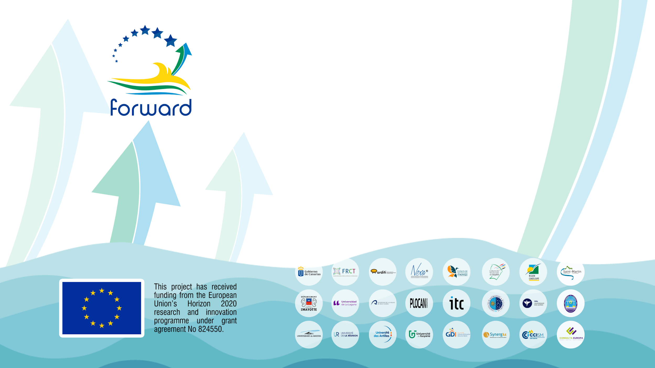
FORWARD
Fostering research excellence in EU outermost regions
Co-creation and implementation of thematic working groups
Ver. 01/06/2020

Slide 2

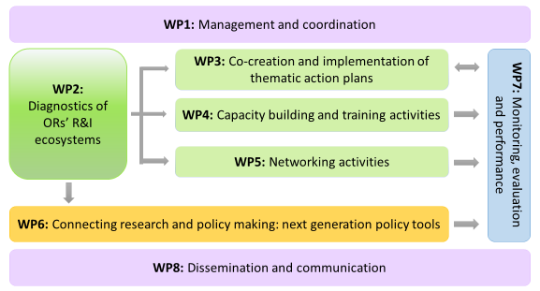
Forward project
FORWARD ‘Fostering research excellence in EU outermost regions’ is a project funded by the European Commission under the Horizon 2020 programme.
Overall objectives :
Improve ORs’ excellence in research and their innovation potential
Improve their participation in EU research and innovation funded projects
Link research activities with territorial development
FORWARD work packages

Slide 3
R&I thematic working groups
TWG1 | Health, applied Medical Technologies, Diagnostics and Therapies
TWG2 | Social sciences and social innovation
TWG3 | Tourism, eco-tourism, nature tourism, cultural tourism
TWG4 | Earth, space & universe sciences
TWG5 | Information and Communications Technology
TWG6 | Climate change and Energy transition
TWG7 | Agriculture, applied life sciences, biotechnology, and bio-systems engineering
TWG8 | Biodiversity conservation and restoration
TWG9 | Marine sciences & technologies

Slide 4
Benefits of participation in Forward Thematic working Groups
R&I researchers from the ORs, Other EU regions and Third Countries, could benefit from:
gain visibility in an international quadruple-helix network,
training and networking activities,
new tenders opportunities and international partners,
elaboration of EU project proposals,
multidisciplinary collaboration,
the co-creation and implementation of thematic work action plans

Slide 5

Building inter-regional
Thematic Working Groups

Slide 6
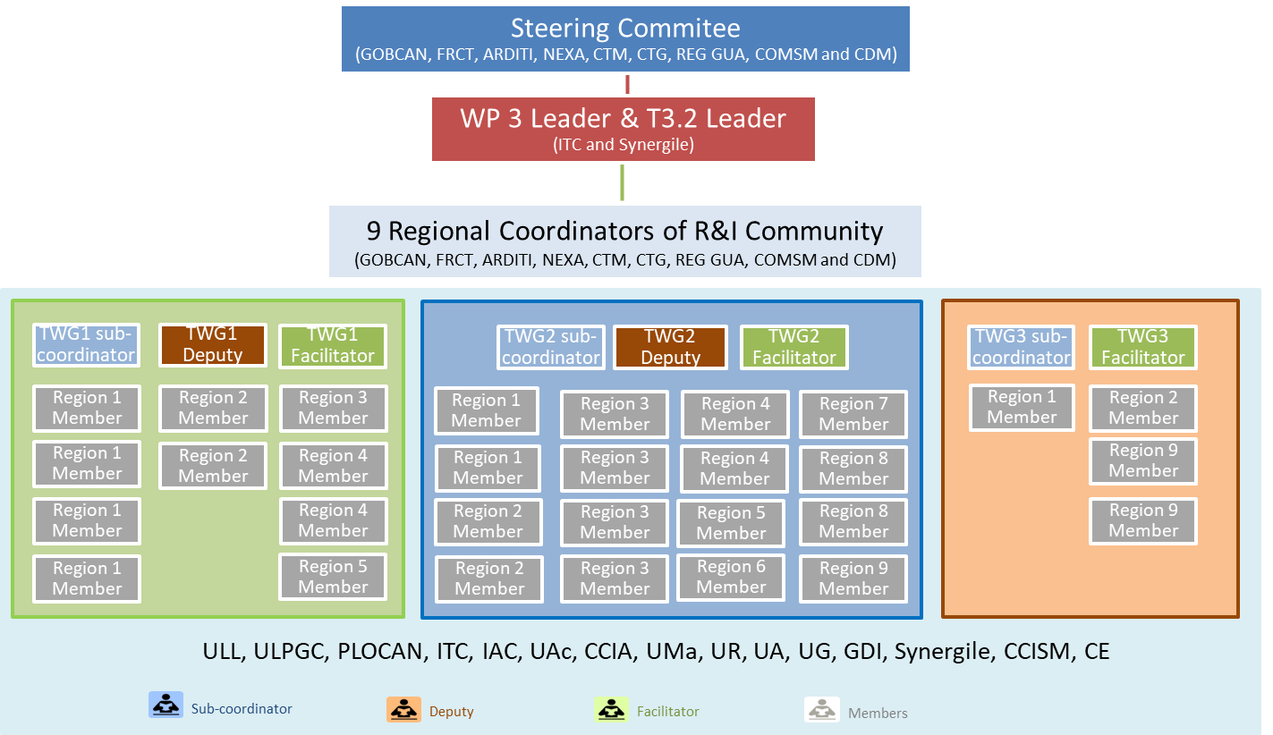
Building inter-regional Thematic Working Groups

Slide 7




Thematic Working Groups Roles
Sub-coordinator: 1 per thematic group
R&I profile proposed by the Forward R&I partners among their members.
Selected/ approved by the Steering Committee within the candidates provided by the Regional Coordinators of R&I Communities.
Deputy: 1 per thematic group (optional)
Selected by the sub-coordinator, as a substitute or assistant, probably within its own organization.
Facilitator: 1 per thematic group
Management profile proposed by the Forward partners among their members.
Selected/ approved by the Steering Committee within the candidates.
Members: as many as possible
R&I profile proposed by the Forward R&I partners among their members.
Other:
Regional thematic experts: Representatives from regional universities, R&I centres, companies, administration, clusters,…
Multisectoral and intersectoral experts
Representatives from European and Third Countries’ institutions and European Experts, who operate in the strategic domain

Slide 8

Thematic Working Groups Roles
Sub-coordinator: 1 per thematic group
Deputy: 1 per thematic group
Chair person of the TWG; management of TWG, web-meetings and online communication tools;
Writing Thematic Action Plan;
Coordination with TWG Regional Contact Points and other members of the group, in order to share and integrate the contributions from each region.
Coordination of WP5 Networking activities in the TWG;
Communication within other TWG and Forward coordination team;
Reporting data for each event / activity, writing a yearly narrative report.
Supporting / replacing sub-coordinator when necessary
Facilitator: 1 per thematic group
Supporting sub-coordinator / deputy, facilitating the management and tasks.

Slide 9
Members Selection Criteria
Thematic Working Groups
At least 3 ORs involved: minimum 5 members from 3 different organizations.
Ex. Evaluation criteria
Sub-coordinator
Belonging to FORWARD partner institution.
R&I profile with expertise in the thematic.
Expertise in European R&I projects, coordination or WP leadership.
Highly motivated.
CV 🡪 link to an online profile (Must be in English).
In the last 5 years:
Most relevant articles related to the TWG published
Research projects managed as PI related to the TWG subsidised by official bodies
Participation in research projects related to the TWG subsidised by official bodies
Doctoral theses directed (concluded)
Patents obtained
National/International mobility experience
Members
Initial members: Identified by the R&I regional institutions.
New members:
  Local members validated by its Regional Coordinator of R&I Community.
  International members validated by Sub-coordinator.

Slide 10

Thematic Working Groups Organization
Specific training: (All sub-coordinators and deputies). Presentation of the FORWARD project and the thematic shortlisted + Introduction of the sub coordinators. Training on a common methodology (online) – June 2020
Individual Kick-off meeting: (each TGW, sub-coordinator, deputy and members) presentation of the FORWARD project. Introduction of the members (online) – June 2020
3 Transregional meetings: All sub-coordinators (if not available can be replaced by the deputy)
2 meetings with the Advisory Board: Each sub-coordinator (if not available can be replaced by the deputy)
At least 2 transregional thematic meetings: Each sub-coordinator + deputy + International Experts + Regional Contact Points + other regional stakeholders (online)
Several regional workshops: Each Regional Coordinator of R&I + experts + other regional stakeholders
MEETINGS

Slide 11


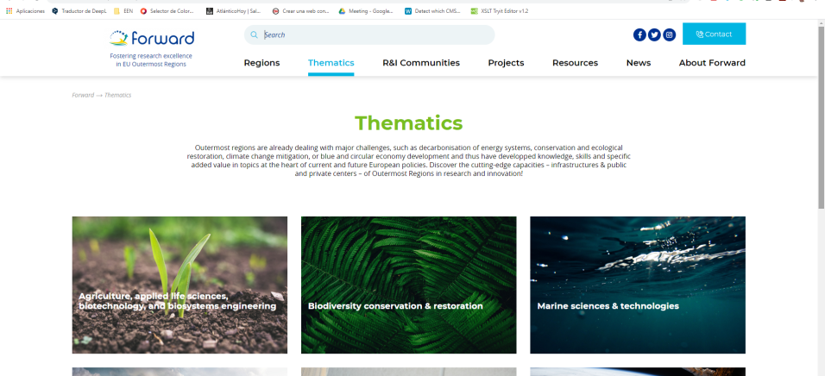

Thematic Working Group Communication Tools
FORUM/ CHAT/ …
ONLINE MEETINGS
SHARE DOCUMENTS
WEB

Slide 12
R&I thematics

Slide 13
Identification of R&I thematics
Nine R&I common thematic among ORs were detected from the diagnosis of ORs research and innovation ecosystems, based on:
RIS3 domains (according to FORWARD proposal).
Ranking on total EU Contribution (including domains with only 1 OR involved)
Ranking of the different fields of expertise (at least 2 ORS, FP + other EU funds)
Potential fields of cooperation between the OR
Alignment with the Horizon Europe pillars

Slide 14
TWG1 | Health, applied Medical Technologies, Diagnostics and Therapies Horizon Europe Pillar 1 , Pillar 2 (Cluster: civil security for society) and Pillar 3
TWG2 | Social sciences and social innovation Horizon Europe Pillar 1, Pillar 2 (Cluster: Culture, creativity and inclusive society) & (Cluster: civil security for society) and Pillar 3
TWG3 | Tourism, eco-tourism, nature tourism, cultural tourism Horizon Europe Pillar 1, Pillar 2 (Cluster: Culture, creativity and inclusive society) & (Cluster: civil security for society) and Pillar 3
TWG4 | Earth, space & universe sciences Horizon Europe Pillar 1, Pillar 2 (Cluster: Industry, digital and space) & (Cluster: civil security for society)
TWG5 | Information and Communications Technology Horizon Europe Pillar 1, Pillar 2 (Cluster: Industry, digital and space) & (Cluster: civil security for society) and Pillar 3
TWG6 | Climate change and Energy transition Horizon Europe Pillar 1, Pillar 2 (Cluster: Climate, energy and mobility) & (Cluster: civil security for society) and Pillar 3
TWG7 | Agriculture, applied life sciences, biotechnology, and bio-systems engineering Horizon Europe Pillar 1, Pillar 2 (Cluster: Food, bioeconomy, natural resources, agriculture and environment) & (Cluster: civil security for society) and Pillar 3
TWG8 | Biodiversity conservation and restoration Horizon Europe Pillar 1, Pillar 2 (Cluster: Food, bioeconomy, natural resources, agriculture and environment) & (Cluster: civil security for society) and Pillar 3
TWG9 | Marine sciences & technologies Horizon Europe Pillar 1, Pillar 2 (Cluster: Food, bioeconomy, natural resources, agriculture and environment) & (Cluster: civil security for society) and Pillar 3

Slide 15
1) Health and applied medical technologies, diagnostics and therapies
The development and fostering of an stronger health system is important for ORs regions due to their distance from Continental Europe and isolation. Likewise, ORs can contribute to the development of R&I related with tropical disease and so on, and being an strategic referent for Third Countries neighbors because of their geographic location and their geostrategic positioning.
Some scientific domains of expertise and policy objectives are:
Study of tropical diseases Development of tools for diagnosis Monitoring and treatment of diseases Pharmacology Public health and Clinical medicine Regenerative medicine Epidemiology and health risk management Health and demographic change | Obesity, diabetes and metabolic diseases prevention Nutrition and health education One health approach Study of tropical infectious diseases

Slide 16
2) Social science and social innovation
Given their diversity and common social problems, the ORs are increasingly engaged in a process of social change to reduce fragility and develop new “enablers” for sustainable economic development. Some of the underlying areas of research and services are:
Methods and tools for social regulation or methods for analysing and understanding social relations Initial and continuing training Education and training policies The fostering of entrepreneurship Ecosystem of interconnected applications (ICT) Database management Sharing Economy Social integration Psychology and Occupational psychology Sociology Negotiation skills Ergonomics Global History Cultural heritage Colonial & postcolonial societies & economies | Island/small economies Vulnerability and sustainability of small island economies Island metabolism Regional innovation systems & policies Multicultural societies Learning in multilingual context Migration Silver economy Social inequalities and inclusion Gender studies and equality Environmental law Environmental justice Ecotones

Slide 17
3) Tourism, eco-tourism, nature tourism, cultural tourism
Tourism is an important economic sector in the ORs, in terms of economic development and job creation, and is included in the RIS3 priorities of the smart specialization strategy in many ORs regions (Canary Islands, Madeira, Açores, Réunion…). Due to its impact, it is important to improve our services and knowledge in relation with the ecosystem and the environmental sustainability, in a way to preserve our territories from massive tourism and its impact.
Some scientific domains of expertise and policy objectives are:
Improving the competitiveness and productivity of the ORs tourism product
Productive diversification based on tourism
Sustainable leadership in tourism
Reduce the production and improve the valorization of waste induced by tourism activities
Cultural services
Social integration
Employment, training and human resources in tourism
Innovation in design for the tourism sector
Strategic planning of tourists destinations
Touristic demand predictions
Smart planning of touristic routes at destination

Slide 18
4) Earth, space & universe science
ORs are facing different kinds of geological threats, like volcanic activity, forest fires, or relevant seismic activity. ORs have also some of the most privileged sites for astronomical observation. The ORs contribute to the development of Earth system, Space & Universe Sciences in the EU due to its geostrategic positioning, as several projects are implemented in the ORs on this field.
Some fields of research/expertise are:
Astrophysical research and astrophysical instrumentation.
Astrobiology, Astroinformatics and Geoinformatics.
Aerospace engineering and monitoring.
Earth observations satellites and remote sensing.
Natural risks related to climate change, meteorology, land cover change, soil erosion, etc.
Physics of earth’s interior, seismology, volcanology.
Very large data bases: archiving, handling and analysis.

Slide 19
5) Information & communications technology
Due to their multidisciplinary nature, ICT plays a transversal role in all thematic areas, such as application or integration, which gives them flexibility and agility in positioning innovation in the market, with great impact. This area should be looked at for its involvement in a significant variety and consequent impact on the regional and global economy. A key area at local, regional, national and global levels is e-government.
Some scientific domains of expertise and policy objectives are:
Economic development
Public administration
Network infrastructure: full broadband coverage of high speed.
Inclusion (a collective awareness platform about poverty support measures
Digital growth: widespread use of advanced IS services by companies and citizens
Digital Single Market
Education
Health (telemedicine for remote islands)
Biodiversity
Ocean and maritime
Climate change management
Tourism

Slide 20
6) Climate change & Energy transition
ORs are especially vulnerable to global warming, in particular, to the rise in sea level and extreme weather conditions. Likewise, the ORs disperse and isolated geographical location in the globe provides an unique opportunity to study its interactions with land and atmosphere. Observations that are organized on a systematic basis for process understanding and model development, or other research or demonstration purposes. ORs have excellent renewable energy resources but they are not being used to their full extent for technical, economic and legislative barriers. Legislative barriers are mostly at national level. Moreover, the situation among ORs is heterogeneous.
Some scientific domains of expertise and policy objectives are:
Climatology and climate change
Forecasting and integration of variable renewables in isolated electricity grids
Energy efficiency, both thermal and electric, including bioclimatic architecture
Integration of variable renewables in (isolated) electricity grids
Small -and medium scale stand- alone energy systems
Smart grids, including micro- and mini-grids and hybrid systems
Transport electrification/descarbonisation
“New” renewable energies such as high enthalpy geothermal energy, off-shore wind energy, wave energy, ocean thermal energy conversion…
Energy storage

Slide 21
7) Agriculture, applied life sciences, biotechnology, and biosystems engineering
The nine ORs significant areas linked to resources (agriculture, forestry…) offering opportunities for developing for example the circular economy and making them important players in governance. Their rich biodiversity – a buffer against storm and flood surges, is also the basis for key economic sectors.
Some scientific domains of expertise and policy objectives are:
Water treatment and waste water management
Agroecology and Valorization of bioresources (phytopharmacy and Phytocosmetics)
Quality of agrofood, food supplements and food security.
Renewal of the agri-food industries by developing specific expertise and products
Bioproducts and Biosystems engineering
Bioeconomy
Micro-organisms, Pathology and molecular genetics: development of genome innovations for selecting varieties adapted to tropical production

Slide 22
8) Biodiversity conservation & restoration
OR are among the most ecologically vulnerable territories of the Union. Indeed, their small size, isolation and high level of endemic biodiversity, make them particularly exposed to anthropogenic and climate-change induced dynamics threatening natural ecosystems on a global scale and the communities which rely on them. It is also a way to turn a threat into an opportunity by positioning outermost regions as living labs of biodiversity conservation and restoration.
Some scientific domains of expertise and policy objectives are:
Biodiversity, Ecology & Conservation of species and ecosystems
Biogeography and evolutionary processes
Terrestrial ecology
Invasive alien species and other environmental risks
Evolution and Interactions in Caribbean, Macaronesian and Indian Ocean Area, and Amazonian systems
Conservation of natural heritage & Understanding of heritage and landscape
Biosphere conservation, social-environmental conflicts, greening of public action

Slide 23
9) Marine sciences & technologies
The nine ORs significant exclusive economic zones linked to marine resources (aquaculture, biodiversity, fisheries...) and are in the front line of climate change, which threaten the use of seas, ocean and coasts and calls for innovative and technological solutions, offering opportunities for developing the blue economy and making them important players in international ocean governance.
Some scientific domains of expertise and policy objectives are:
Aquaculture and fisheries
Biodiversity, marine ecology and Conservation, Coral reef health...
Desalination systems for water scarcity affected regions with high insolation
Marine spatial planning and management of marine resources and ecosystems
Marine renewable energies, hydrogen, off-shore wind energy, wave energy, floating solar panels , ocean thermal energy
Marine multiuse platforms
Maritime-tourist sector
Science and technologies of the sea
Oceanography

Slide 24
FORWARD project
Sources consulted:
Forward website
The Outermost Regions, European territory in the wider world (European Commission, 2017)
2019 ERC Evaluation panels and keywords
Eye@RIS3: Innovation Priorities in Europe
Developing Horizon Europe
Sustainable Development Goal

Slide 25

How to join Forward TWG?
Deadline: until 10th June
Registration Form

